Slide 1
The Importance of Healthcare
Quality
Dr. Md. Emdadul Haque
National Consultant(HEU)

Slide 2
Why does Quality matter?
Increases the health status of individuals and the population
Poor quality can do harm
Social and economic benefits
Increases the efficiency of the health system

Slide 3


Slide 4

Oh dear!

Slide 5

Who should care!

Slide 6

Solve priority
Quality problems …

Slide 7
Every SYSTEM achieves the RESULTS for which it was designed!

Slide 8

Deming Cycle

Slide 9
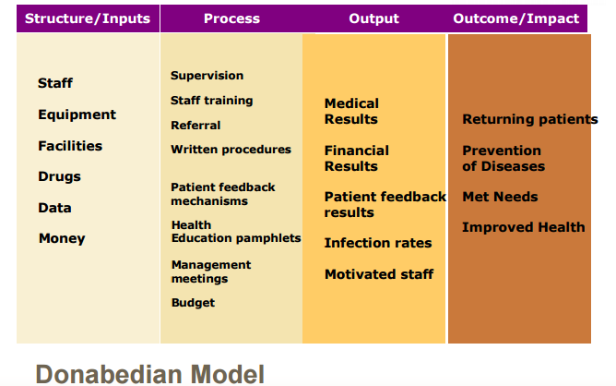

Slide 10
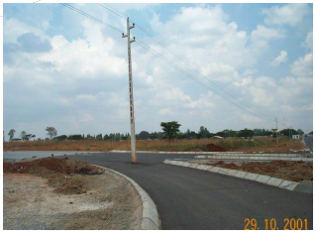
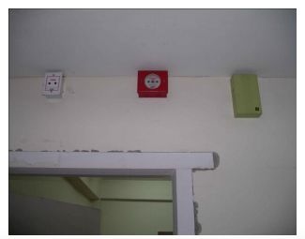
Quality Improvement
Although all improvement involves change,
not all changes are improvement.

Slide 11

Our usual solution:
We need more RESOURCES!!!!

Slide 12


Slide 13



KAIZEN(CQI)
A frontline-based problem solving approach
Incremental but continuous progress

Slide 14


INNOVATION
Dramatic but intermittent progress
THE IDEAL
ACTUALITY
Higher standard achieved through innovation is subject to deterioration unless continuing efforts are made first to maintain it and then to improve it

Slide 15
KAIZEN PLUS INNOVATION
Desirable progress by combination of two opposing approaches
MAINTENANCE
INNOVATION
NEW STANDARD
KAIZEN
MAINTENANCE
INNOVATION

Slide 16


Slide 17





Changes in Surgery & Pediatric Word in Jhenaidah Sadar Hospital
Before
After
Before
After

Slide 18
People connect the links
“No quality management system works
unless people are empowered and
committed to take responsibility for quality
-as an ongoing process –
in the end, quality becomes part of people's behavior and attitudes”
Dr. Joseph Juran

Slide 19

Thank You
Notes:
19

